Slide 1
CREATIONAL DESIGN PATTERN

Slide 2
Prototype
Prototype design pattern is one of the creational design patterns. It allows us to specify objects which are prototypes of original objects. In other words, it allows us to copy existing objects instead of making new instances.
Prototype Design Pattern is mainly used when creating new objects from scratch is expensive and we are already having similar classes for creating such objects.
With the help of Prototype Design Patterns, we copy new objects from already existing classes and modify these objects according to our new requirements.
For Prototype Design Pattern, it is mandatory to have a copy feature in existing objects. If we want to create prototypes of our object, we need to implement/define a clone() method for that object/class. Although, it depends on our design and requirement whether to use a shallow or deep copy of the existing objects.

Slide 3
Shallow Copy - In shallow copy, we only clone the parent object and not its containing objects.
In shallow copy, we copy references of the Original object, and hence if we make any changes in one of the objects, those changes get reflected in other objects as well.
Deep Copy - In a deep copy, we clone the parent object as well as its containing objects.
In a deep copy, we copy the original object with its values so after copying, both the objects are independent of each other, and hence, if we make any changes in one object, that change does not get reflected in the other object.

Slide 4
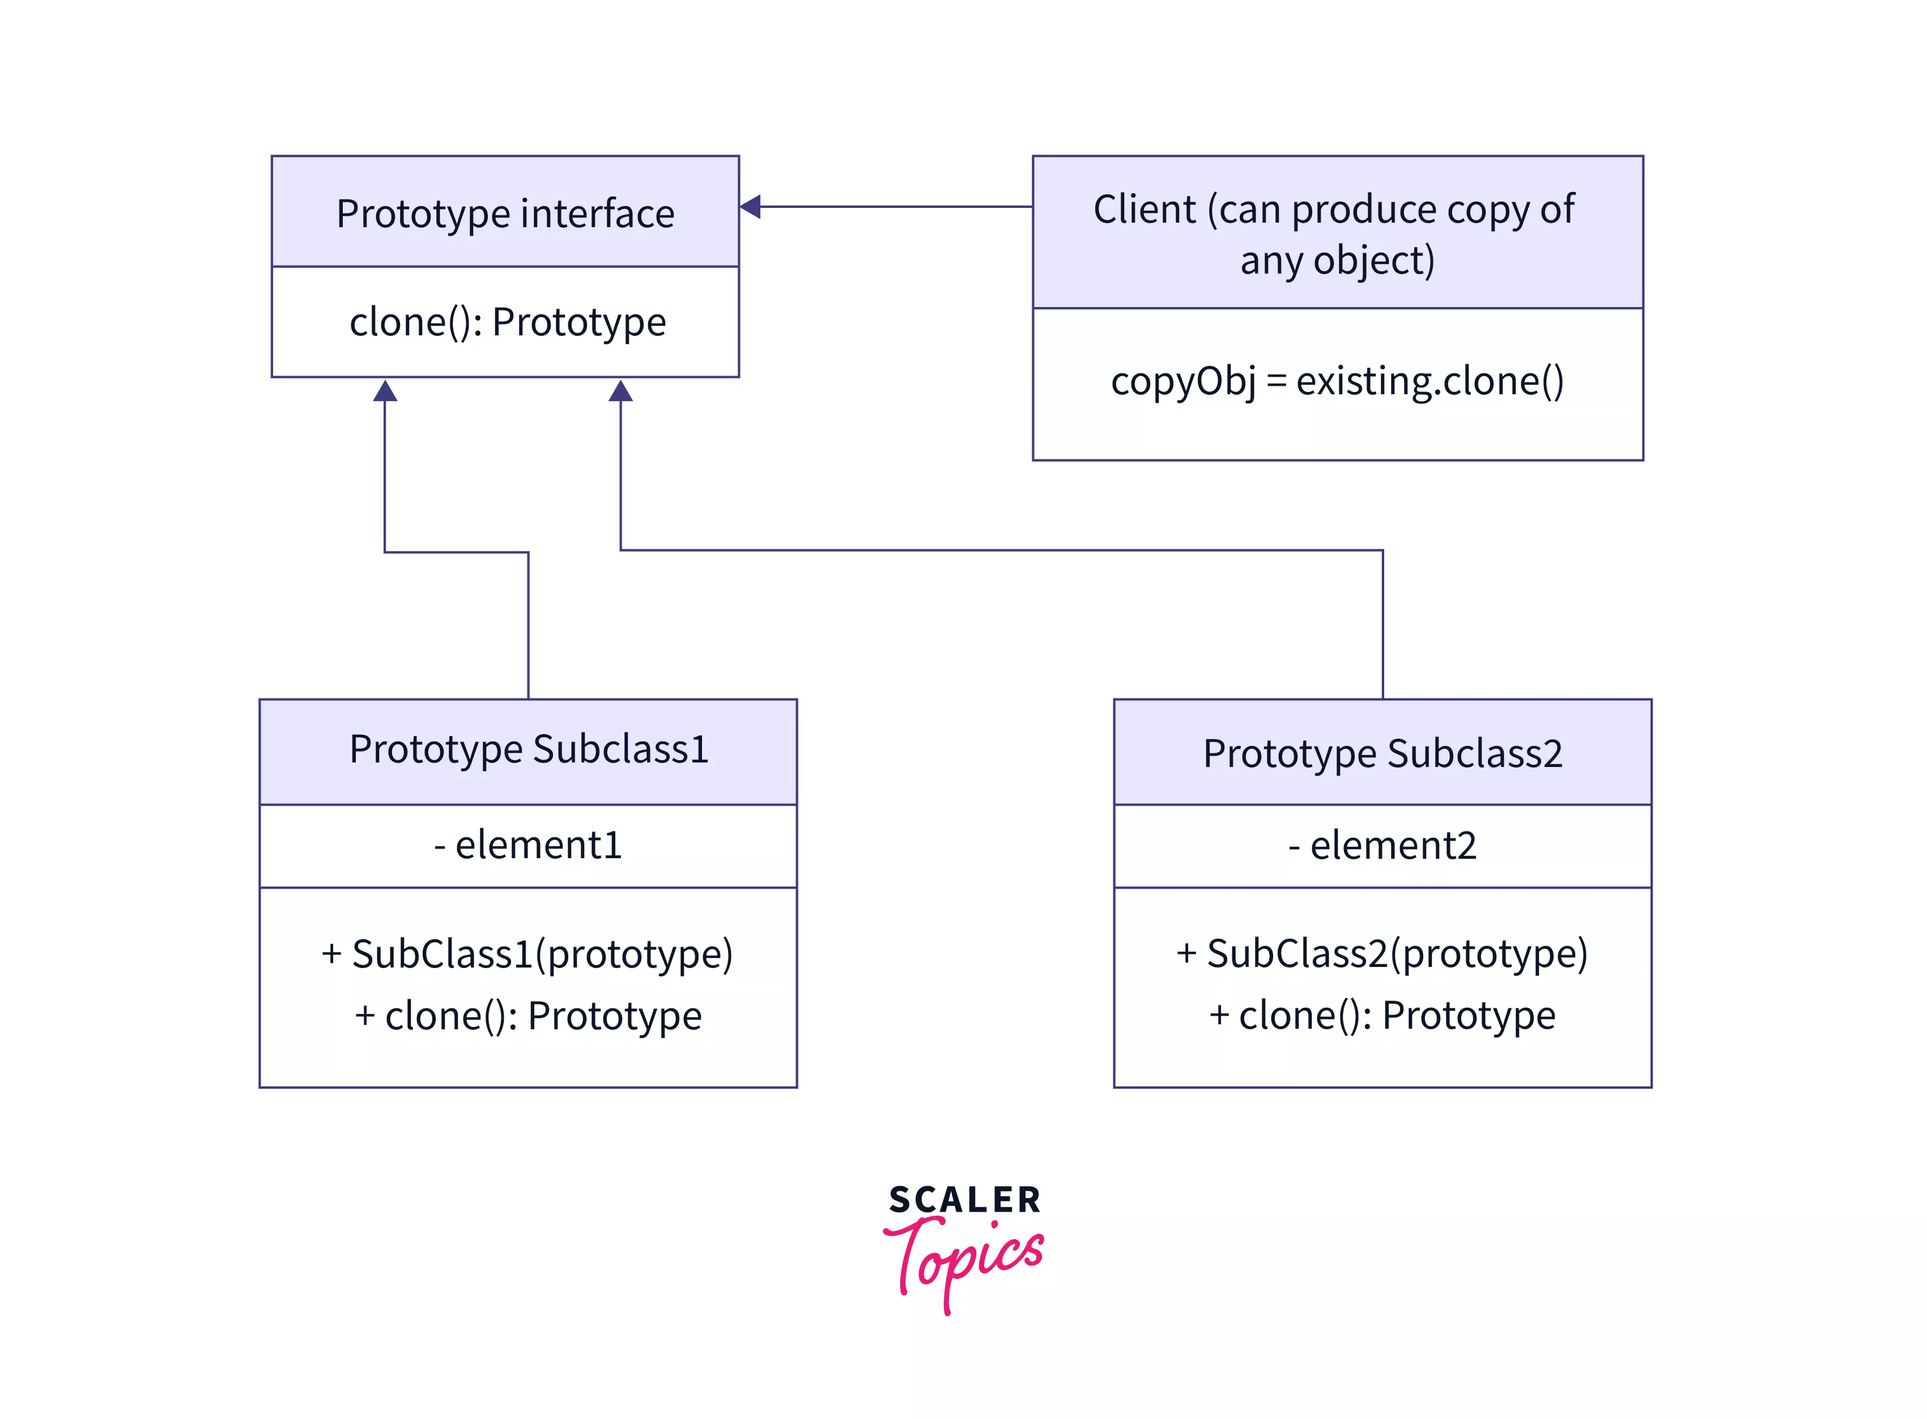
https://www.scaler.com/topics/design-patterns/prototype-design-pattern/

Slide 5
Prototype Design Pattern | Flyweight Design Pattern
Prototype is a creational pattern. | Flyweight is a structural pattern.
In the prototype, we create a duplicate object by cloning. | In Flyweight, we reuse the existing object.
In the prototype, the object is mutable. | In Flyweight, the object is immutable.
Prototype is about saving cost by making a copy of the existing object. | Flyweight is about saving memory by not creating new objects but rather reusing the existing ones.
Prototype is used when the need is to create a single type of single object. | Flyweight is used when the need is to create multiple types of single objects.
We are creating an object here so it comes under a creational pattern. | It is not a creation of objects but a sharing of them which is usually held in some external data structure, it is under a structural pattern.
The basic difference is that the Prototype former makes deep copy. | Whereas the Flyweight makes shared object and uses it.

